Slide 1



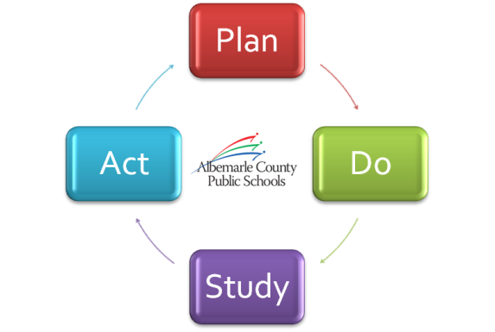


A Look at Our Strategic Performance
2012-13 Q4/EOY Progress Summary
August 22, 2013

Slide 2
Goal 1
Lifelong Learning
Learning Spaces
Goal 2
Performance Tasks
Goal 3
Engagement
Goal 4
Goal 5
Strategic Plan Review
Strategic Communications
Program Valuation
Academic Excellence Scorecard

Slide 3
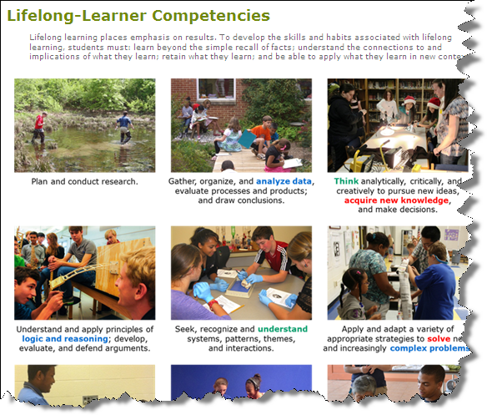
Goal 1
Lifelong Learning
Reinforced through Performance Tasks
Spring Survey

Slide 4
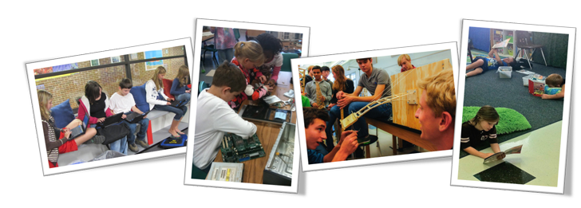
Goal 1
Learning Spaces
PD related to design principles

Slide 5

Goal 2
Performance Tasks
98% of students in grades K-12 participated in division performance assessments
CAI 2013
Notes:
As students throughout the Division complete performance tasks, results are being collected and organized for analysis. The next phase of this work will take place in CAI 2013.

Slide 6


Goal 3
Employee Recognition
“We Notice”
Employee Feedback Used in Continuous Improvement
Notes:
Attracting and retaining high quality personnel and a commitment to building the quality of our own workforce is essential. Employee engagement, a School Division priority, continues to be an area of focus. After analyzing the results of our employee climate survey from last spring and sharing them with the School Board, the “Engagement Focus Group” landed on one item that we are seeking to explore: employee recognition. Back in November, we sent a survey to Principals and Directors to study our current state of recognition practices. We shared a summary of that information with leaders to identify the areas they wanted to hear more about. By offering these ideas and tools, our goal is to increase employee engagement. The HR Team provides support to leaders in the implementation of these best practices within their schools/departments.

Slide 7

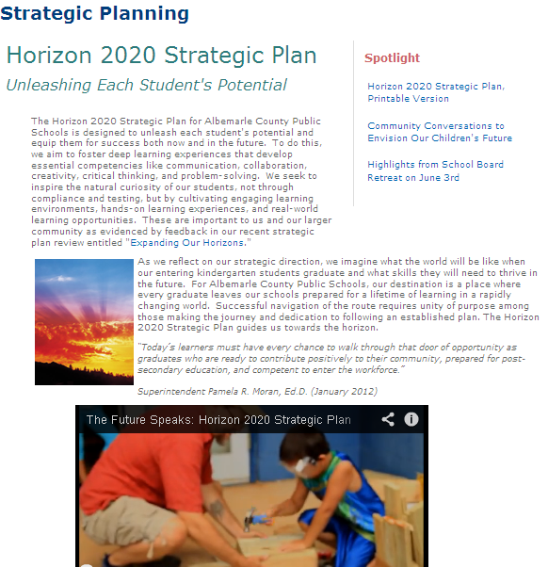
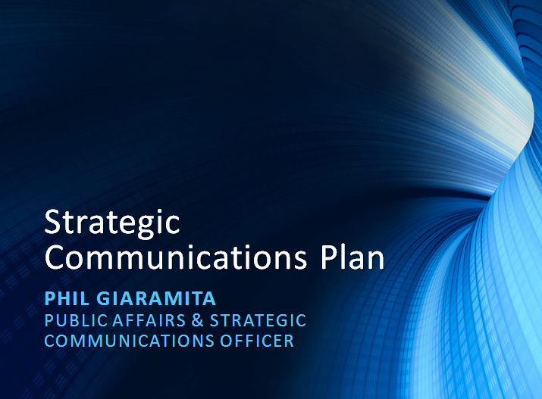
Goal 4
Strategic Plan Review
Strategic Communications Plan
Academic Excellence Scorecard
Strategic Plan Review
Completed
Communications Plan
Recommendations Planned or Already Underway
Quality Learning Indicators
Horizon 2020 Strategic Plan

Slide 8

Goal 5
Valuation
Proposal under review
Notes:
We are in conversations with K12 Insight to connect this work to our strategic plan review outreach efforts.

